Slide 1
INFORMATION HIDING
Generated by DALL-E
INTRODUCTION
Adib Nikjou, Shiraz University of Technology, Spring 2025

Slide 2
Lecture Overview Digital Watermarking, Steganography, and Encryption
1. Information Hiding
Definition: What does “information hiding” encompass?
2. Digital Watermarking
Definition: What is digital watermarking
Name Origin: Why do we call it “watermarking” ?
History & Present Use: When and how did it begin, and how is it applied today?
3. Steganography
Definition: What is steganography?
History & Present Use: How was it used in the past, and how do we use it now?
4. Encryption
Definition: What is encryption?
5. Comparison
Differences: How do digital watermarking, steganography, and encryption differ?

Slide 3

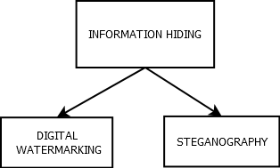
The World of Information Hiding What It Covers
Information Hiding,
often referred to as encapsulation in software design,
involves the communication of information by
embedding it in and retrieving it from other digital data.
Information Hiding is the overarching concept,
encompassing both Digital Watermarking
and Steganography.
Depending on the application, these processes
may need to be imperceptible, robust, secure,
and meet other specific requirements.

Slide 4
Historical Foundations The Origins of Information Protection
Throughout history, humans have developed three main approaches to protecting information:
Authentication (Watermarking)
Concealment (Steganography)
Scrambling (Encryption)
Each method emerged from different needs and evolved along distinct paths, yet all three remain crucial in today's digital world.
Each of them will be discussed in this lecture.

Slide 5
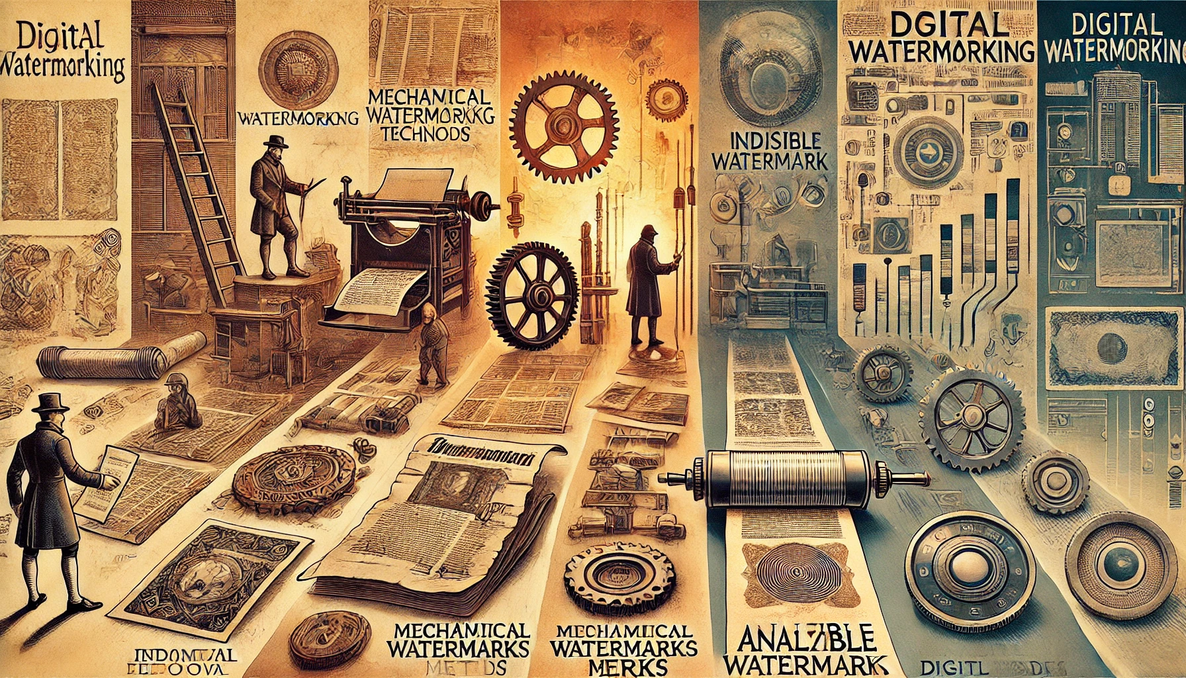
introduction
WATERMARKING
Generated by DALL-E

Slide 6
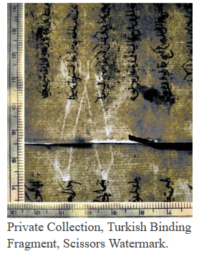
Historical Foundations Ancient Beginnings - Watermarking
The story of watermarking begins in 13th century Italy:
Paper manufacturers in Fabriano developed the first watermarks
Created by pressing wire patterns into paper during manufacturing
Used to identify paper makers and verify document authenticity
Became standard practice across Europe by 1300s
Still used in modern currency and official documents

Slide 7
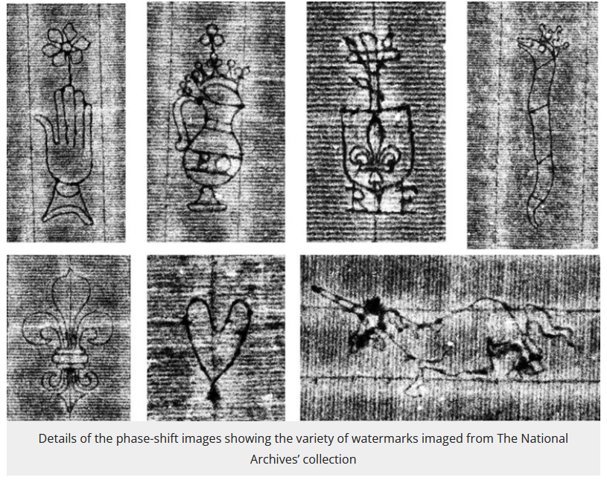
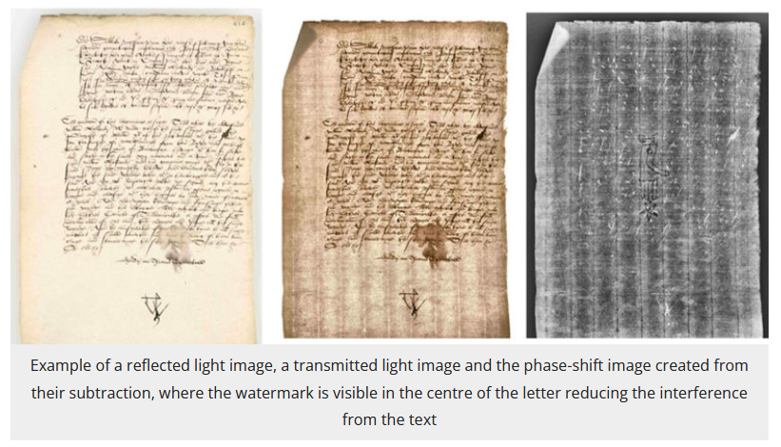
Historical Foundations Ancient Beginnings - Watermarking

Slide 8
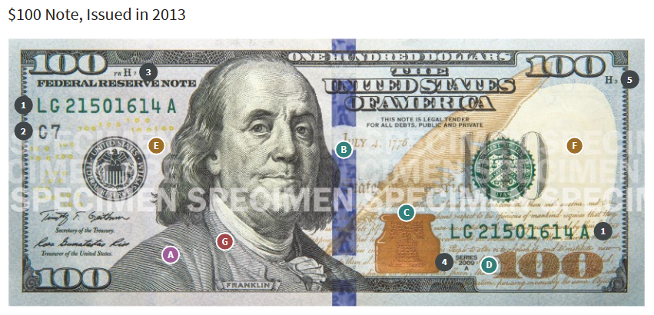
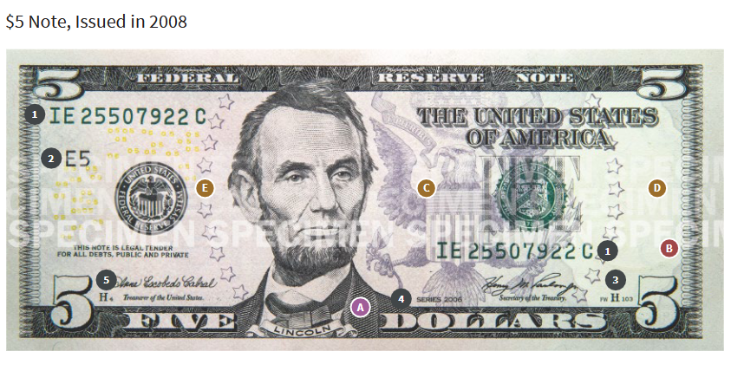
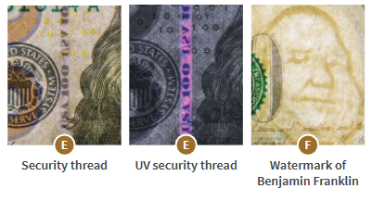
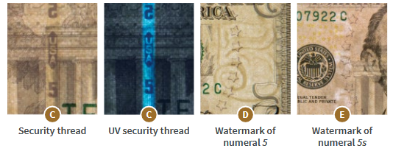
Historical Foundations Ancient Beginnings - Watermarking

Slide 9
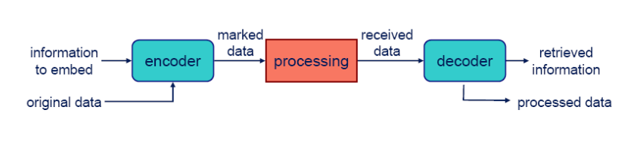
What is Digital Watermarking? Digital Watermarking: The Invisible Guardian
Digital watermarking is like giving your digital content a unique, invisible fingerprint. Imagine signing your name in invisible ink on a painting – it's there, but viewers can't see it without special tools.
Similarly, digital watermarking embeds information within digital content in ways that are typically invisible to human perception but can be detected by computer systems.
Think of digital watermarks as invisible guardians that travel with our content wherever it goes, providing different types of protection and functionality depending on our needs.

Slide 10
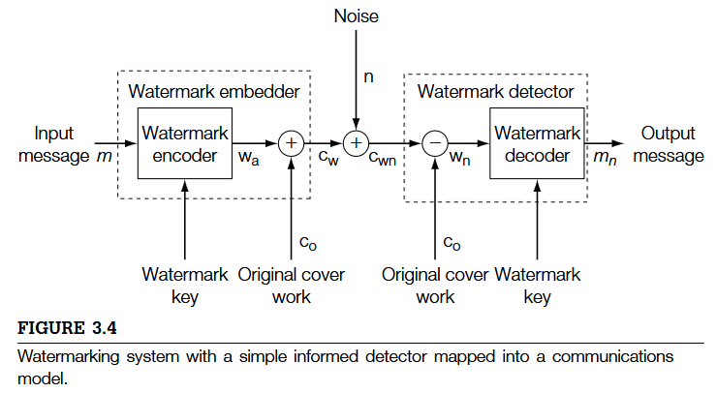
What is Digital Watermarking? Digital Watermarking: The Invisible Guardian
We may use encryption as a supplementary tool to enhance security, but it can also draw attention.

Slide 11
The Digital Revolution and Security Challenges Why Digital Security Matters Today
The digital revolution has transformed how we create, share, and store information. Consider these facts:
Over 2.5 quintillion bytes of data are created every day
Digital content can be perfectly copied instantly
Information travels across global networks in seconds
Digital assets have significant monetary and strategic value
This transformation brings new vulnerabilities:
Data can be intercepted during transmission
Digital files can be modified without leaving visible traces
Perfect copies make ownership difficult to prove
Global connectivity increases attack surfaces

Slide 12
The Role of Digital Watermarking Digital Watermarking in Modern Security
Digital watermarking represents a crucial tool in our security arsenal:
Protection Mechanisms:
Embedding ownership information directly into content
Creating tamper-evident digital media
Enabling content tracking and verification
Key Advantages:
Persists within the content itself
Can survive format conversions and processing
Provides proof of ownership and authenticity
Works alongside other security measures

Slide 13
Applications in the Real World Digital Watermarking in Action
Digital watermarking serves numerous practical purposes:
Copyright Protection:
Embedding ownership information
Tracking unauthorized distribution
Providing proof of ownership
Content Authentication:
Detecting tampering
Verifying content integrity
Ensuring source authenticity

Slide 14
Applications in the Real World Digital Watermarking in Action
Broadcast Monitoring:
Tracking when and where content(Mostly Advertisement) is aired
Verifying advertising broadcasts
Collecting usage statistics
Medical Applications:
Protecting patient information
Ensuring image authenticity
Linking images to patient records

Slide 15
Copyright Protection and Content Ownership Protecting Creative Works
Copyright protection represents one of the most fundamental applications of digital watermarking. When an artist creates a digital painting or a photographer captures a stunning image, watermarking helps them maintain control over their work in the digital space.
Implementation Examples:
Professional Photography: Studios embed photographer information and usage rights
Digital Art: Artists include proof of authorship and licensing details
Stock Photo Services: Track image usage and verify licensing compliance
Real-World Impact: A professional photographer embeds watermarks containing their studio information and licensing terms in their wedding photos. When these images appear on unauthorized websites, the photographer can prove ownership and request removal.

Slide 16
Content Authentication and Integrity Verification Ensuring Digital Trust
In an era where digital content can be easily manipulated, content authentication becomes crucial. Digital watermarking serves as a powerful tool for verifying that content hasn't been tampered with.
Key Applications:
Legal Documents: Courts use watermarking to verify document authenticity
News Media: News organizations authenticate original footage
Medical Imaging: Hospitals ensure patient scan integrity
Practical Example: A hospital embeds patient information and acquisition parameters directly into X-ray images. Any modification to the image disrupts the watermark, alerting medical staff to potential tampering.

Slide 17
Broadcast Monitoring and Advertisement Tracking Tracking Content in the Wild
Broadcast monitoring represents a sophisticated application of watermarking technology, allowing content owners to track when and where their content appears across various media channels.
Implementation Scenarios:
Television Broadcasting: Networks track program airtime
Advertisement Verification: Agencies confirm ad placement
Music Industry: Radio play monitoring for royalty calculations
The watermark contains:
Unique content identifier
Timestamp information
Source identification
Broadcasting rights data

Slide 18
Broadcast Monitoring and Advertisement Tracking Tracking Content in the Wild
Broadcast Monitoring Historical Example: The Big Picture
In 1997, Japanese TV stations booked more air time than they delivered.
Advertisers paid for ads that were never shown.
Monitoring tracks every broadcast to prevent such issues.
One solution(Passive systems): compare live signals to known content.
But a better solution(Active systems): add hidden codes (watermarks) into the broadcast.
Watermarks confirm when and where each clip is aired.
(Cox, I. J., Miller, M. L., Bloom, J. A., Fridrich, J., & Kalker, T. (2007). Digital watermarking and steganography (2nd ed.). Morgan Kaufmann.)

Slide 19
Digital Forensics and Security Watermarks as Digital Detectives
Digital watermarking plays a crucial role in forensic applications, helping investigate the origin and distribution path of digital content.
Applications in Security:
Government Documents: Tracking classified information leaks
Corporate Security: Identifying sources of confidential information breaches
Digital Currency: Anti-counterfeiting measures
Case Study: A company embeds unique watermarks in confidential documents distributed to different departments. When information leaks occur, they can trace the source by examining the watermark.

Slide 20
Properties of Effective Watermarks What Makes a Good Digital Watermark?
An effective digital watermark must balance several crucial properties:
Imperceptibility: The watermark should not noticeably degrade the host content. Like a well-designed security system, it should protect without interfering with normal use.
Robustness: The watermark must survive common content modifications:
Compression and format conversion
Filtering and enhancement
Geometric transformations
Cropping and resizing
Security: The watermark should resist deliberate attempts to remove or modify it without severely damaging the host content.
Capacity: The amount of information that can be embedded while maintaining other properties.

Slide 21
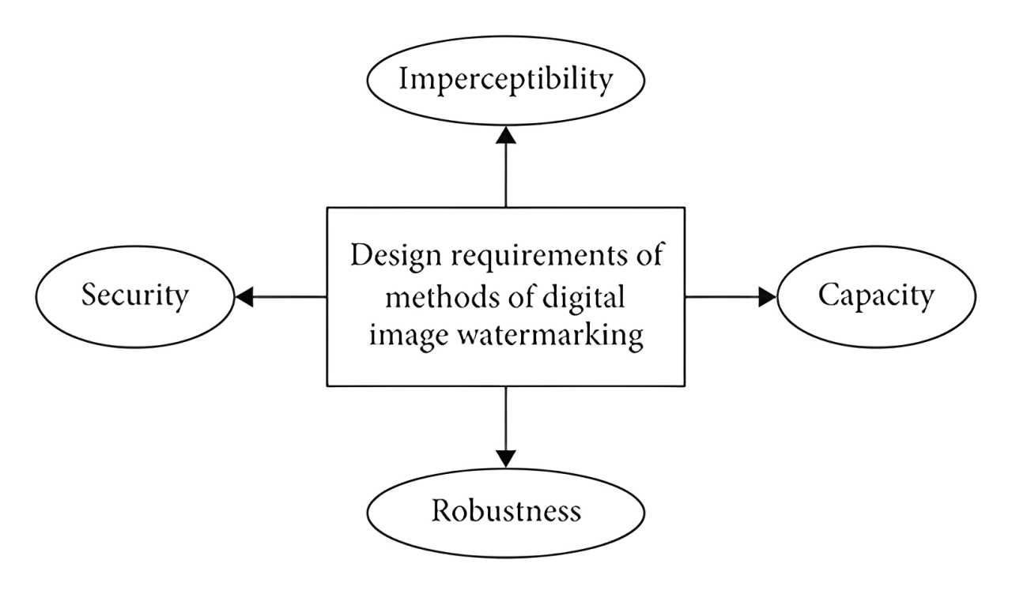
Properties of Effective Watermarks What Makes a Good Digital Watermark?

Slide 22
The Science Behind Digital Watermarks How Digital Watermarking Works
Digital watermarking works by making subtle modifications to the original content. These modifications can be made in different ways:
Spatial Domain:
Directly modifying pixel values
Making tiny adjustments to color or brightness
Changing least significant bits of pixel data
Frequency Domain:
Modifying transform coefficients (DCT, DWT, FFT)
Embedding information in specific frequency bands
Taking advantage of human perception limitations

Slide 23

The Art of Watermark Placement Understanding Embedding Domains
Spatial Domain (Direct Embedding)
In the spatial domain, we modify the content directly, much like painting on a canvas. Think of it as making tiny adjustments to the building blocks of digital content:
Images and Video:
Pixel Values: We can subtly alter the brightness or color of individual pixels
Bit Planes: Changes to the least significant bits cause minimal visual impact
Block-Based: Modifications to groups of pixels for better robustness
Audio:
Sample Values: Small changes to audio samples that human ears can't detect
Time Domain: Modifications in the waveform that preserve sound quality

Slide 24
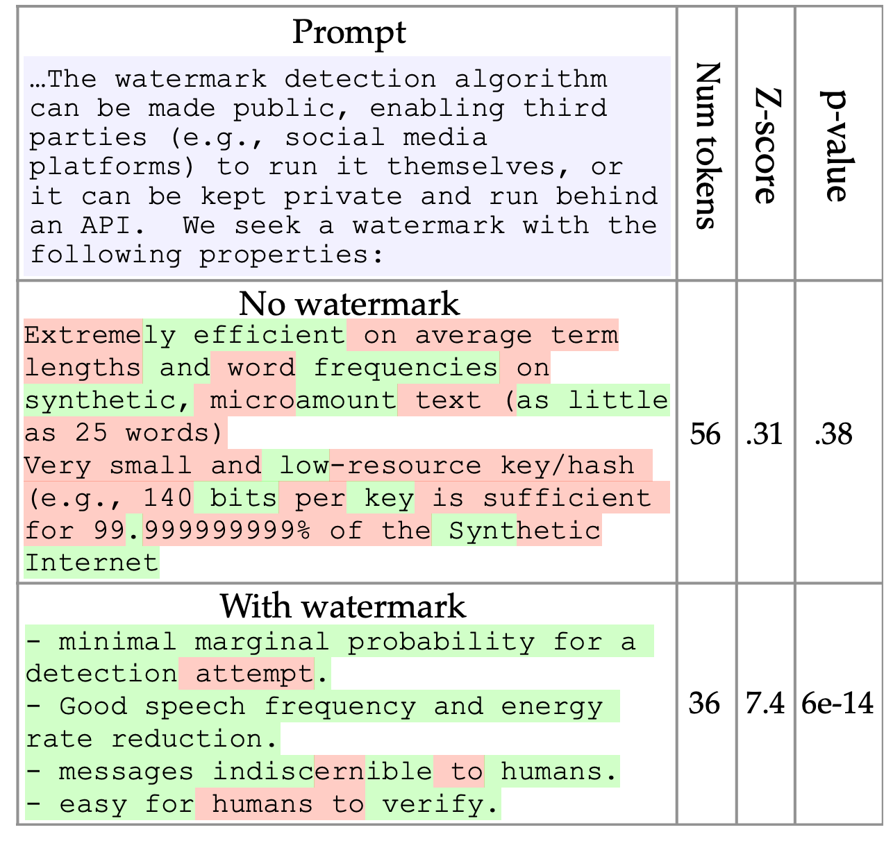
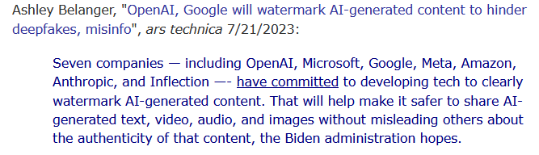
The Art of Watermark Placement Understanding Embedding Domains
Paper: A Watermark for Large Language Models
Text Documents:
Character Spacing: Slightly adjusting the space between
letters or words
Line Spacing: Making microscopic changes to line heights
Word Shifting: Minimal adjustments to word positions
Example: ChatGPT uses Text Watermarking
Link to the Paper: | arXiv:2301.10226

Slide 25
The Art of Watermark Placement Understanding Embedding Domains
Transform Domain (Frequency-Based)
Transform domain embedding is like working with the DNA of digital content rather than its visible features. We modify mathematical representations:
Frequency Transforms:
Discrete Cosine Transform (DCT): Used in JPEG images
Discrete Wavelet Transform (DWT): Excellent for multi-resolution analysis
Discrete Fourier Transform (DFT): Particularly good for audio watermarking
Key Benefits:
More robust against compression and processing
Better control over perceptual impact
Stronger resistance to various attacks

Slide 26
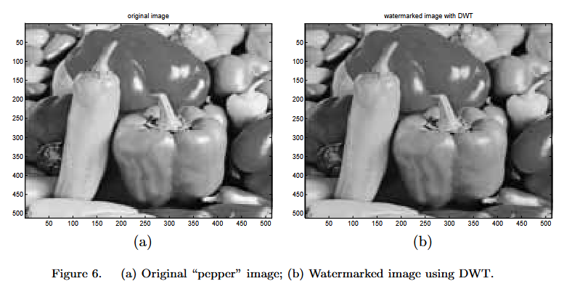
The Art of Watermark Placement Understanding Embedding Domains
Transform Domain (Frequency-Based) (Cont’d)
Xiang-Gen Xia, Charles G. Boncelet, and Gonzalo R. Arce, "Wavelet transform based watermark for digital images," Opt. Express 3, 497-511 (1998)

Slide 27
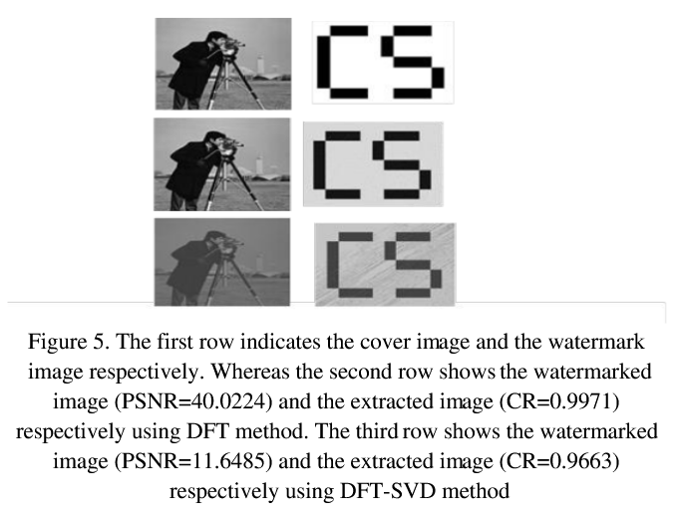
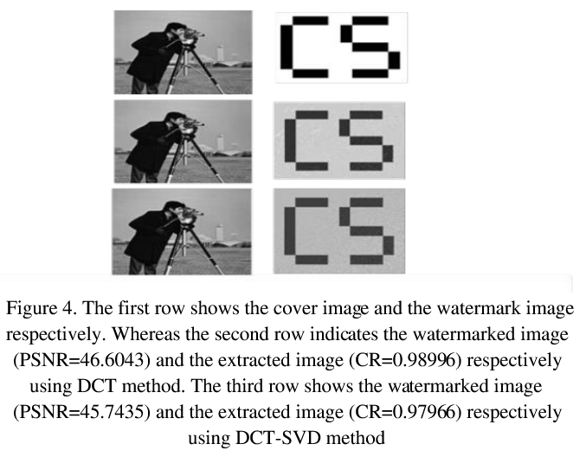
The Art of Watermark Placement Understanding Embedding Domains
Transform Domain (Frequency-Based) (Cont’d)
Paper: Abd-Elsalam, Rabha & Saleh, Sahar. (2024). Digital Image Watermarking Methods Based on Transformation Techniques: A Comparative Study.

Slide 28
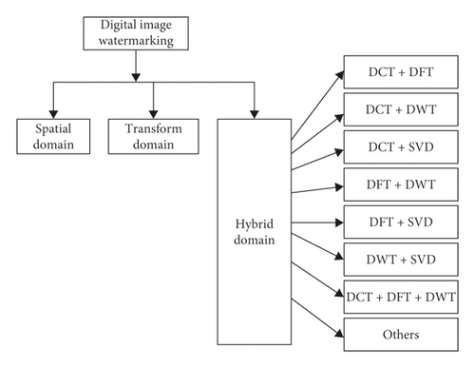
The Art of Watermark Placement Understanding Embedding Domains
Hybrid Approaches
Modern watermarking often combines multiple
domains for optimal results.

Slide 29

Types of Digital Watermarks The Watermark Family Tree
Visible Watermarks:
Like traditional paper watermarks
Clearly visible to viewers
Used for branding and deterrence
Example: Television station logos
Invisible Watermarks:
Hidden from human perception
Detected through software
Used for authentication and tracking
Example: Copyright information in photographs

Slide 30
Types of Digital Watermarks The Watermark Family Tree
Fragile Watermarks:
Designed to be destroyed by modifications
Used for tamper detection
Example: Document authenticity verification
Robust Watermarks:
Designed to survive modifications
Used for copyright protection
Example: Broadcast monitoring

Slide 31
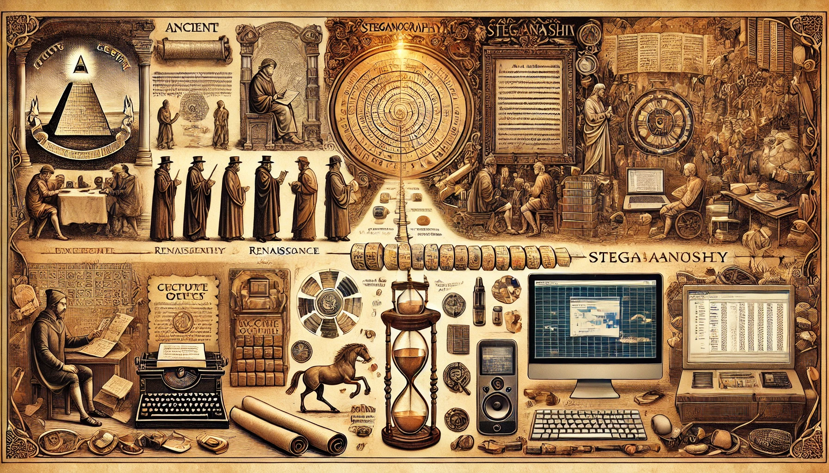
introduction
STEGANOGRAPHY
Generated by DALL-E

Slide 32
Historical Foundations Ancient Steganography
The art of secret communication has fascinated humanity for millennia. Steganography, from the Greek words 'steganos' (covered) and 'graphia' (writing), emerged in ancient civilizations as an ingenious way to transmit secret messages.
Ancient civilizations demonstrated remarkable creativity in hiding messages:
The Messenger's Growing Secret
The Silk Sphere Strategy
The Organic Invisible Script

Slide 33
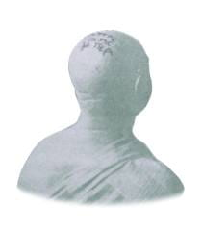
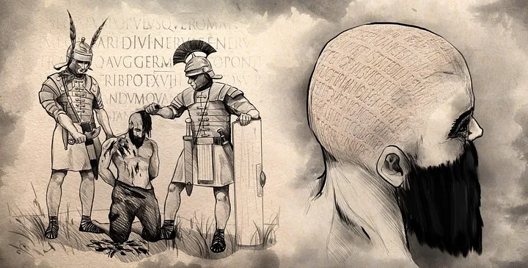
Historical Foundations Ancient Steganography
The Messenger's Growing Secret (500 BCE)
In a masterful display of ancient steganography, the Greek ruler Histiaeus devised an ingenious method to send a secret rebellion message while under Persian surveillance. As documented by Herodotus in "The Histories," Histiaeus tattooed his message onto a trusted slave's shaved head. After waiting for the hair to regrow and conceal the writing, the slave traveled safely to Aristagoras, who revealed the hidden message by shaving the head again.
This early example of steganography demonstrated a timeless principle: sometimes the most effective way to hide a message is within something that appears completely ordinary. Through this living message system, Histiaeus successfully bypassed Persian spies and delivered his call for rebellion.

Slide 34

Historical Foundations Ancient Steganography
The Silk Sphere Strategy
In ancient China, officials devised an elegant method of secret communication using one of their most precious materials - silk. Messages were carefully inscribed on fine silk sheets, which were then expertly compressed into tiny spheres and sealed with wax. The result appeared as nothing more than an innocent wax ball, concealing its valuable intelligence within.
In times of danger, these ingeniously crafted spheres offered an additional layer of security - trusted messengers could swallow them to ensure absolute secrecy during transit. Once safely delivered, the wax coating would be removed to reveal the hidden message, demonstrating the sophisticated understanding of steganographic principles in ancient Chinese statecraft.

Slide 35
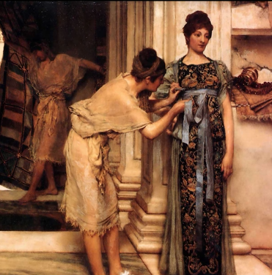
Historical Foundations Ancient Steganography
The Organic Invisible Script
Ancient Rome, from the 1st century BCE, gave birth to an ingenious steganographic method using nature's own chemistry. Romans discovered that everyday organic materials like milk and fruit juices could serve as sophisticated invisible inks.
The process was brilliantly simple yet effective: messages written with these organic solutions dried completely clear on parchment, appearing as blank paper. When heat was applied, as documented by Pliny the Elder and Ovid, the organic compounds would oxidize, transforming the invisible writing into visible brown text. This technique proved invaluable for concealing everything from sensitive state affairs to secret love letters.
The method demonstrated how ordinary materials could become powerful tools for hidden communication, setting a foundation for future steganographic innovations. The Romans' organic invisible ink became one of history's most elegant solutions for transmitting secret messages in plain sight.

Slide 36
What is Digital Steganography? The Art of Concealing Digital Information
Digital steganography is the art and science of hiding digital information within covert channels in a way that prevents the detection of the hidden message.
Unlike digital watermarking, which focuses on protecting image content and copyright, steganography's primary concern is concealing the very existence of hidden data.
While watermarking embeds information related to the host content's attributes (like ownership or authenticity), steganographic messages are typically unrelated to their carrier files.
Another key distinction lies in their priorities: steganography emphasizes embedding capacity and complete concealment, whereas watermarking prioritizes robustness and maintaining image quality.
The fundamental requirement of a steganographic system is that the resulting stego-image must be perceptually indistinguishable from the original to avoid raising suspicion.

Slide 37
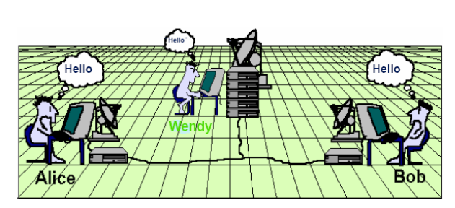
Steganalysis The Art of Detecting Hidden Messages
The art of hiding information meets its match in steganalysis. Like a digital detective, steganalysis examines files for hidden messages by analyzing statistical patterns and subtle changes. This forces modern steganographic techniques to carefully balance their hiding capacity against remaining undetectable.

Slide 38
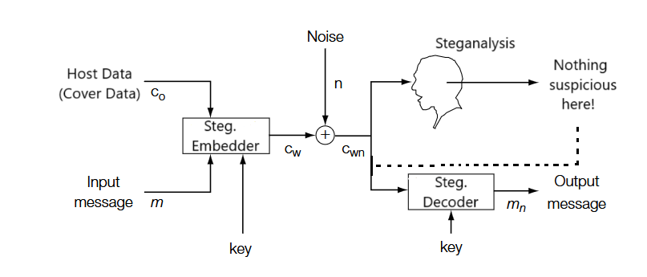
Steganalysis The Art of Detecting Hidden Messages
The secret message should remain undetected not only by the human eye, but also by steganalysis.

Slide 39
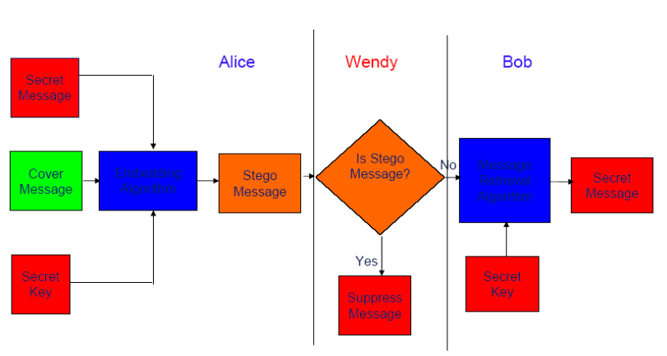
Steganalysis The Art of Detecting Hidden Messages
Steganalysis isn't concerned with what the secret message contains. it simply aims to prevent its transmission.

Slide 40
Steganalysis The Art of Detecting Hidden Messages
To understand how steganalysis works in practice, let's examine some pivotal moments in history where this detection science played a crucial role.
World War II (1939-1945): British counter-intelligence officers developed some of the first systematic steganalysis techniques to detect German spy communications. They discovered that German agents were hiding map coordinates and other military information in seemingly innocent newspaper advertisements. By carefully analyzing patterns in the advertisements' wording and placement, British intelligence was able to uncover these hidden messages.

Slide 41
Steganalysis The Art of Detecting Hidden Messages
Cold War Era (1960s):
The National Security Agency (NSA) developed advanced steganalysis methods to detect messages hidden in diplomatic communications. They discovered that some countries were embedding secret information in routine embassy transmissions by slightly altering the spacing between words and lines - a technique that required sophisticated statistical analysis to detect.

Slide 42
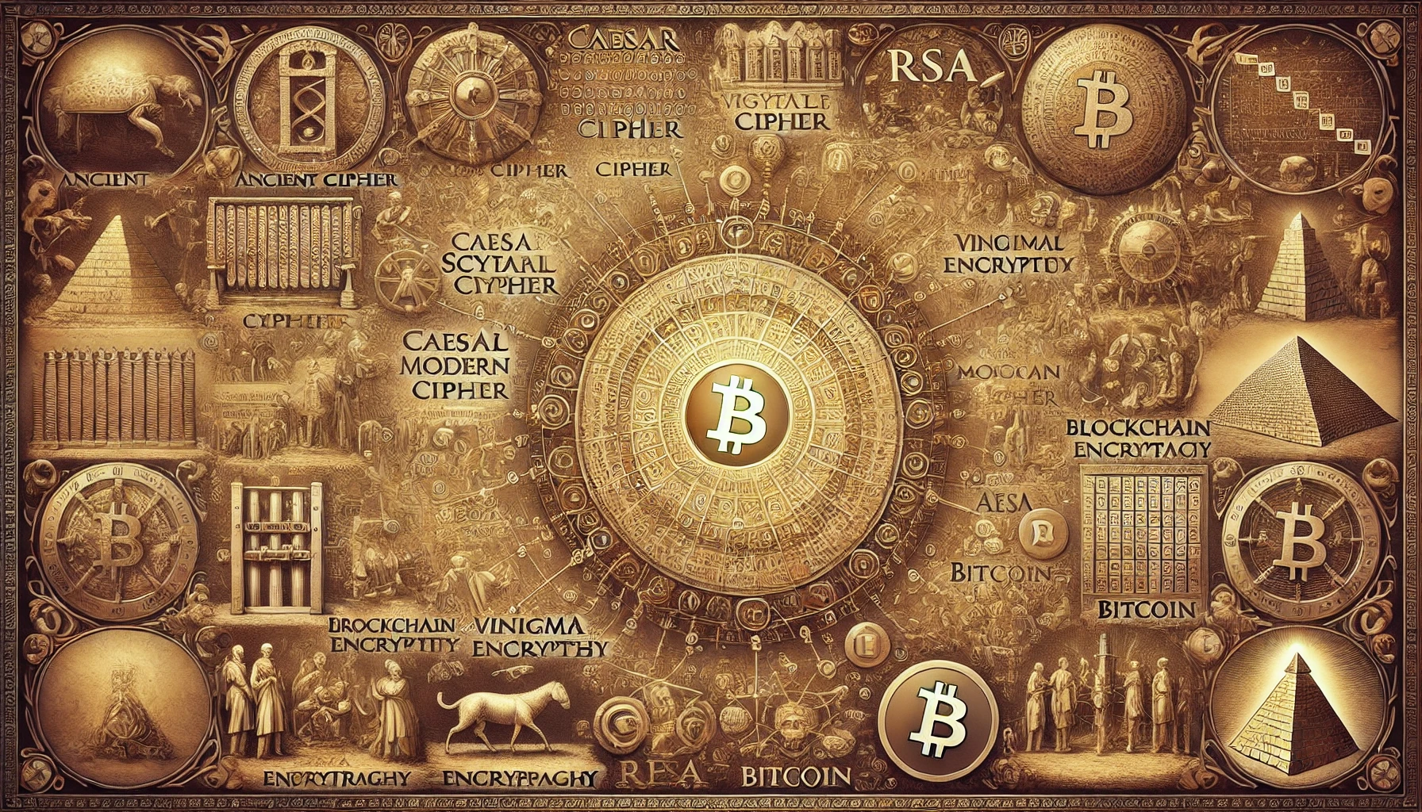
introduction
ENCRYPTION
Generated by DALL-E

Slide 43
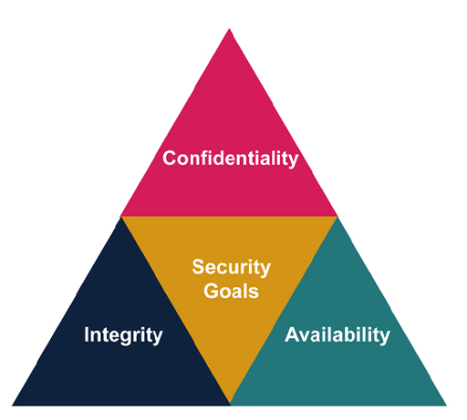
Core Principles of Information Security The Three Pillars of Information Security
Modern information security is built on three fundamental principles:
Confidentiality (Supported by Steganography)
Ensuring information is accessible only to authorized parties
Protecting against unauthorized access and disclosure
Examples: Medical records, financial data, personal communications
Integrity (Supported by Watermarking)
Maintaining accuracy and completeness of information
Preventing unauthorized modification
Ensuring data remains trustworthy and reliable
Availability (Supported by Watermarking)
Ensuring authorized users can access information when needed
Maintaining system functionality and performance
Protecting against service disruptions

Slide 44
Securing Information Encryption vs. Information Hiding
The three pillars of security can be achieved not only through information hiding techniques such as watermarking and steganography but also through encryption. These methods work together to protect data by ensuring confidentiality, integrity, and authenticity.
This raises two important questions:
If information hiding techniques like watermarking and steganography can help achieve the three pillars of security, then why do we still need encryption?
How do these methods differ, and what are their advantages and disadvantages?

Slide 45
Information Hiding vs. Encryption Why Both Matter
Information Hiding (Watermarking & Steganography) helps achieve security by concealing data within other media.
However, if the hidden data is discovered, it may still be accessed.
Encryption ensures that even if data is exposed, it remains unreadable without the decryption key.
Combining both methods enhances security, making it more difficult for attackers to access or manipulate sensitive information.

Slide 46
Information Hiding vs. Encryption Differences, Pros & Cons
Key Differences:
Encryption converts data into an unreadable format, requiring a decryption key for access.
Information Hiding embeds information within data, ensuring its presence even after distribution.
METHOD | ADVATAGES | DISADVANTAGES
Encryption | Guarantees confidentiality through mathematical complexity. High Capacity Does not degrade content quality that much. | Once decrypted, data is exposed and can be copied freely It draws some attention. Needs key management.
Information Hiding | Tamper-evident, survives format conversions. Conceals message existence (does not alert observers) Does not need Key Management. | May degrade content quality if poorly implemented Low capacity; vulnerable to statistical analysis. Hidden data can be extracted if discovered.

